Slide 1


Save / Export Slide Deck as PDF
Smart Digital Library
PRESENTED BY: SALOME BARANES & NOA RAZLAN

Slide 2

Save / Export Slide Deck as PDF
The Problem: Traditional Library
Remote Accessibility & Convenience
Waitlist
Ratings & Reviews

Slide 3






Save / Export Slide Deck as PDF
Libraries
FastAPI
SQLite3
Jinja2

Slide 4
Save / Export Slide Deck as PDF
Schema Architecture
Table Name | Description
Users | id_user, user_name, email, full_name and passwords.
Books | id,title, author, summary, category, prices, and rating.
Loans | id, id_user, book_id, borrow dates, return_due_date , actual_return_date.
Waitlist Ratings | id, book_id, id_user, joined_day and ratings. id, id_user, book_id, rating_value and review_text.

Slide 5

Save / Export Slide Deck as PDF
Strict Backend Validations
1. Active Loan Limits
2. Overdue Account Locks
3. There is no double loans.

Slide 6
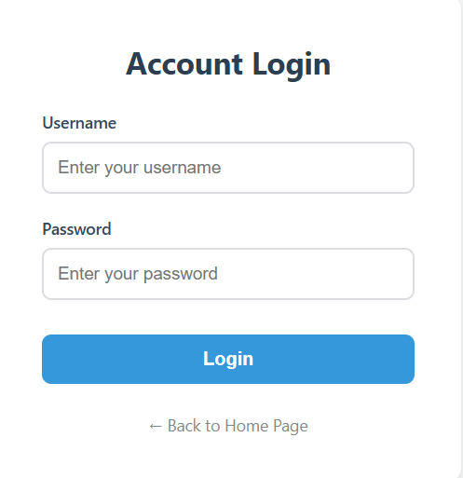
Save / Export Slide Deck as PDF
User & Profile
נננ
Login and create account
2. watch profile

Slide 7
Save / Export Slide Deck as PDF
Books
נננ
search book and author
2. Book Recommendations
3. Book Ratings and Comments
4. view book details

Slide 8
Save / Export Slide Deck as PDF
Loans
נננ
Borrowing a free book
2. return book
3. limit time
4. list of all books borrowed

Slide 9
Save / Export Slide Deck as PDF
Availability management
נננ
marked book as loan or not
2. Preventing double borrowing
.

Slide 10

Save / Export Slide Deck as PDF
Chronological Waitlist Algorithm
If the book is on loan, you can join the waiting list.

Slide 11

Save / Export Slide Deck as PDF
Verified Ratings & Average Scores
Validation: Only verified customers who completed full returns are authorized to submit stars and reviews.
Dynamic DB Recalculations: The backend computes averages on post-requests and commits immediate updates to Books rating row columns.

Slide 12

Save / Export Slide Deck as PDF
Questions & Answers
Thank you for your time and attention!
Developer: salome.shalom@example.com

